Slide 1
SCRAPING THE DARK WEB
Case study: Online markets for illicit drugs in Georgia
Ian Goodrich, CRRC Georgia
Ironhack, December 2020
Notes:
Hello everyone. My name is Ian, I’m a researcher and policy analyst based in Tbilisi, Georgia. After spending the last ten or so years in the humanitarian sector, I have recently moved to quantitative research. For the last year and a half, I’ve been working with CRRC Georgia, the South Caucasus’ leading research institute for the social sciences.
It strikes me that a few of you may be taking part in this bootcamp as part of a career change, for those who are, I’m probably not that much further down that path than you. I’m going to talk about a project right now, but I’m saving 20 minutes for questions at the end. Whilst I’m sure you’ll have lots of questions about the research, I’m quite happy to talk about career stuff then too.
So. I love to use Python in my research, particularly for scraping, API access, and data analysis. I also grudgingly use R for on surveys and particular sorts of modelling. Researchers in the social sciences often really struggle to find good, relevant data to support their work, and often have to rely on small surveys, or manually collected and coded data – which can be difficult and time consuming to collect and often offer only a limited picture of what we’re trying to study.
What I find really exciting about tools like scraping and data APIs, is that we can directly observe real human behaviour at scale. Today, I’m going to talk to you about what scraping can tell us about the use of illegal drugs, but similar approaches can be used to study an incredibly wide array of activity: from police behaviour to corruption in public procurement, and from tax evasion to the impact of Covid on asset prices. We have incredible tools at our disposal to acquire large, rich, and comparatively complete data which we can use to answer really difficult questions.
I’m going to talk to you today about a research study I worked on earlier in the year. I’ve gone for a bit of a cyberpunk theme with my slides, partly because I’m used to doing very dry presentations and saw this as a chance to have some fun, and partly because I think as a project, it contains all the elements of a good cyberpunk story: we’re got designer drugs a secret parallel internet, technology-enabled gangsters at war with government agents, and a thriving nightlife in post-industrial decline. It was a fun and exciting project to plan and implement, and I hope it will inspire you to go out and try a little scraping yourselves.
You’ll also be pleased to hear it’s got a lot of Python. My focus for the presentation is going to be on the background, planning and results of my study. I’m not going to spend time going over code, partly as I’m self taught and I don’t think your instructors would appreciate me teaching you bad habits, and partly because it’s all up on Github anyway and you can read it at your leisure. I’ll have links at the end of the deck which I’ll share at the end.
I’ll start off by going over the background to my work, explaining what I’ve been looking at and why; I’ll then spend much of the presentation explaining how I went about gathering and analysing my data, and talking through some key decisions. I’ll then finish off with my findings and we’ll have some time at the end for you all to ask questions.

Slide 2
BACKGROUND
Drugs in Georgia
Drugs Online
Research Questions
Project Overview

Slide 3

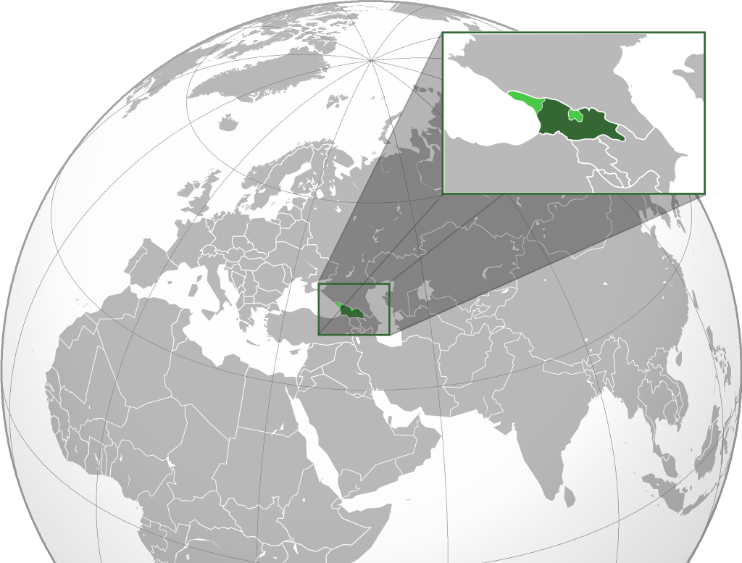
DRUGS IN GEORGIA
Historically high injecting drug use, #2 per capita globally
Changing patterns of nightlife and drug use
Stimulants, New Psychoactive Substances
High profile drug deaths
Notes:
Our story is set in the Republic of Georgia. That’s the Republic of Georgia, between Russia and Turkey. Not to be confused with the State of Georgia in America. It’s a small country, with a population roughly the size of Berlin – over a third of which live in the capital, Tbilisi.
Georgia has a long and troubled history with drug abuse. Until recently most work on drugs in Georgia has focused on opioids, such as heroin and buprenorphine, and quite rightly so – some estimates put Georgia’s per-capita rate of injecting drug use at around 2 percent of the adult population, the second highest rate in the world.
In the last five years, however, we’ve seen radical changes to the way young Georgians in particular take drugs. The biggest change has been driven by a thriving club scene, centered around a number of large techno venues, such as Bassiani pictured on the left there.
We’ve seen increasing evidence that younger Georgians are moving away from injected opiates to stimulants more associated with club culture, such as MDMA, amphetamines, and a few weirder ones I’ll come to later.
With these changing use patterns have come changing risks. The summer of 2018 saw two separate and high-profile drug-death incidents. Firstly, in a case that led to a major police raid of the Bassiani nightclub, five young people died after mistakenly taking what is now thought to have been the powerful synthetic opioid, fentanyl. In a separate incident, one festival-goer died and three were hospitalized after taking an unknown substance at the Echowaves festival in Anaklia.
For me, this is a public health issue requiring a policy response. Whilst cannabis is tolerated, all other drugs are already highly illegal and carry long prison sentences for possession of small quantities. So if drugs are already highly illegal, and people are taking them anyway, what else can the government do to decrease the risks of death and injury from drug use?
Well we can look at things like education, training of healthcare staff, psychological support for starters, but there are a large range of different policy interventions that can be used to reduce risk. But before we can even start thinking about that. There’s a lot of stuff we need to know:
- First of all, we need to know what people are taking, and which substances are most frequently used,
We also need to know who’s taking them, how much they cost, how strong they are.
Policy needs to be made based on strong evidence, and with drugs in particular it’s quite hard to get good information. You can’t just walk up to a drug dealer and ask them how much they sold last week.
Or can you?

Slide 4
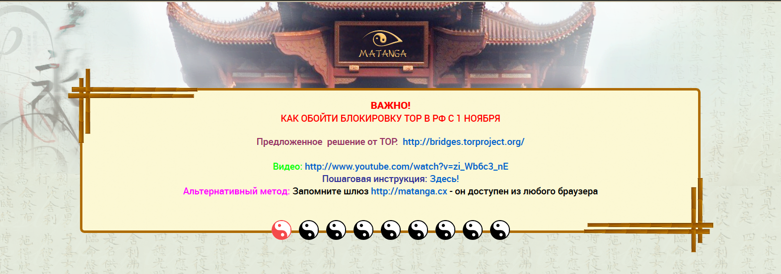
DRUGS ONLINE
Drugs bought online
Matanga largest platform operating in Georgia
Bought in bitcoin, delivered using “dead drop” system
Scraping opportunity!
Notes:
Some of the media coverage of the deaths suggested that the drugs the clubbers had taken had been bought online.
I did some digging and came across a site called Matanga. Matanga is largely Russian language, and operates in Russia, Ukraine, Belarus, Kazakhstan and Georgia. As far as I can tell, it’s the largest of its kind operating here.
It works a lot like Ebay: sellers can set up a shop online, offering whatever it is they have to sell. Users can then log on, buy their drugs – often using bitcoin – and collect them from a hidden location. The collection process is almost like a treasure hunt. Sellers hire people to hide packages around the city, with customers collecting their purchases using GPS coordinates.
There are actually lots of sites like this worldwide, and other researchers have used web-scraping to find out more about drug markets in Europe and the US; but there was nothing similar being done in Georgia.
So this is where the project comes in.

Slide 5
RESEARCH QUESTIONS
How much trade is conducted via the Matanga platform?
What substances are being sold online in Georgia through the Matanga platform in what volumes?
What actions may be taken to mitigate against risks posed by the substances identified?
Notes:
What one really should do with a project like this is begin with a clearly defined goal in mind. For a research study, this is typically framed by research questions. These are the questions I came up with to guide my project, and which I used to frame my final report. If you try something like this, I’d strongly advise doing this _before_ you start collecting data, because you’ll find yourself faced with a lot of decisions and having a clear goal in mind can simplify choices.
So, I was interested in:
How much trade is conducted via the Matanga platform?
What substances are being sold online in what volumes?
What actions may be taken to mitigate against risks posed by the substances identified?

Slide 6
PROJECT OVERVIEW
Collection
Processing
Analysis
Web scraping (Selenium, TorBrowserDriver, BeautifulSoup, pandas)
Sales estimation (pandas)
Data cleaning (pandas, transliterate, forex-python, re)
Statistics (statsmodels, pandas)
Charts (seaborn, matplotlib)
Substance labelling (pandas, Excel !!)
Notes:
So, what did the project look like? I’ll now give you a quick overview of the project structure and the technologies used, before talking through some of the more interesting areas of each component.
For me, there were three basic elements to what I needed to do. I needed to collect the data, I needed to process it into a useable form, and I needed to analyse what I’d processed.
In terms of my toolkit, I used a lot of Python, and you’ll see I leaned very heavily on Pandas throughout. If you’re just learning Python, I can really recommend getting to know Pandas inside out. It’s a huge library with loads of super useful features, and it’s the one tool I find myself using in most projects.
Data collection of course entailed scraping. For this I used Selenium with a driver for Tor browser, along with BeautifulSoup for parsing. It’s a bit of a weird setup, and I’ll talk about how I ended up doing it that way in a moment.
For processing, I needed to clean my data, which mostly involved ensuring all my data was in the same alphabet, currency, and ready for the next steps. I needed to ensure that each listing was properly labelled – this was a pain and actually involved Excel at times. I also needed to estimate sales. I’ll talk about these last two steps in detail later.
Analysis, as with many of these projects, was actually relatively straightforward once I had all the data in place. It was pretty much a case of running a lot of stats and making pretty charts. A lot of pandas again here, but also statsmodels for statistics, and seaborn and matplotlib for the charts.
I’ll now spend most of the rest of the talk going through these steps.

Slide 7
SCRAPING
Target Data
Design Considerations
Implementations

Slide 8
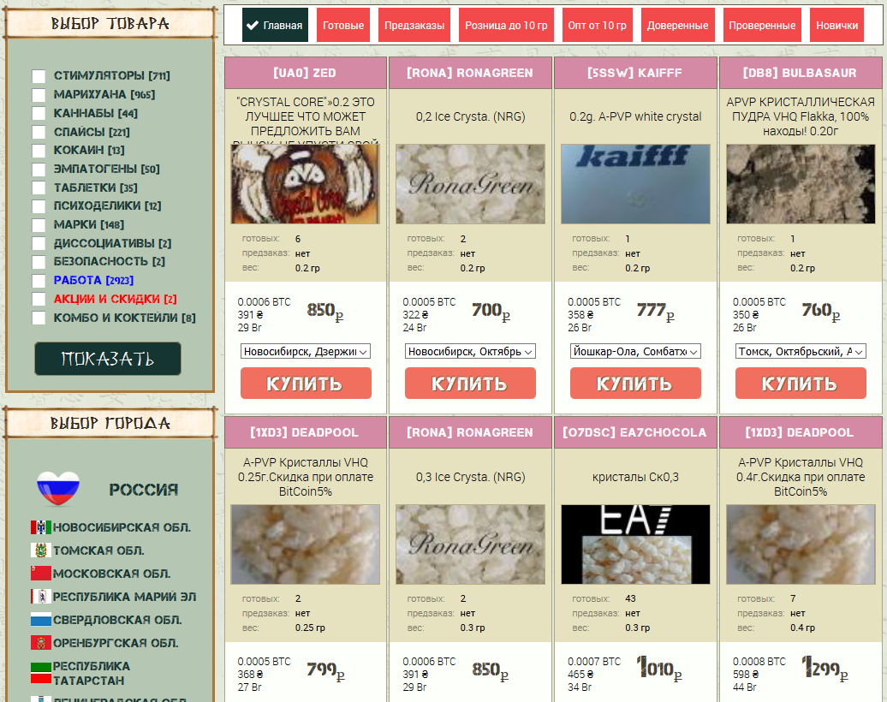
TARGET DATA
Seller
Description
Stock
Weight
Substances
Countries
and cities
Price
Location
Notes:
So a critical step before starting scraping is to understand the site. We need to know which fields we want to capture, and which links we want to follow to iterate through our pages.
In terms of our capture data, on Matanga, we have the following fields.
Up at the top, we see the pseudonym of the vendor
Just below that a description of the product
Below that we see two very important fields, which say “ready” and “pre-order” when translated from Russian. These represent the vendor’s stock. Ready stock is already hidden somewhere, pre-order may be bought by arrangement. More on this later.
We have the weight of the listing, usually in grams. With substances such as Ecstasy or LSD, this sometimes refers to the number of pills or blotters being sold.
We have the price, in a range of currencies.
We also see the town a product is sold in, and occasionally districts within a town.
We have two sets of category filters which we can use for link following. Substances and countries/cities. I actually ended up using the country/city field for link following, which brings me nicely to a discussion of design considerations.

Slide 9
DESIGN CONSIDERATIONS
CONSIDERATIONS
SOLUTIONS
Avoiding detection
Unreliable substance labelling
Blocked in Georgia
Unreliable site
Access to reviews requires CATCHPAs and login
Minimal scraping (only Georgia), randomized waits, browser emulation
Semi-automatic labelling
ToR/VPN
A lot of try/except and babysitting
Use data available without login
Notes:
Before starting coding, it’s really worth thinking long and hard about how you want to achieve your goals. In retrospect, I wish I’d spent more on this process as it would have saved me a lot of pain later.
There were a number of issues with what I was doing and the way the site functioned that influenced my approach to building the scraper.
First and foremost, I wanted to avoid detection. Mainly because the part of the site I was using didn’t have anti-scraping measures, and I didn’t want them to start putting up obstacles once they realized what I’m doing.
This meant keeping scraping minimal. Both in terms of speed and scale. If you’re making hundreds of requests per minute, a server admin is going to notice something is happening.
I also only took the data I needed to take, which was records for Georgia.
There are other approaches here. I could have used something like scrapy which uses automatic link following to capture the whole site. This would have given much a much more interesting dataset, but would have been much slower and more complicated to implement. I decided to keep it simple and just loop through a small section of the site.
I randomized wait times between requests, as evenly spaced requests would also look suspicious.
I also made my requests through a browser to make my scraper’s behaviour appear more authentic. This was perhaps unnecessary and ended up causing more problems than it solved, particularly because I wasn’t using any of Selenium’s automation features and just parsing with BeautifulSoup.
For each listing, it was critical to be able to say what substance each listing corresponds to. For example, I want to say that this particular listing by weedman420 is for cannabis. There were two ways I could have done this:
As we saw before, the site provides category sections. I could have followed these links and labelled from there. The problem with doing this was that the categories provided weren’t used particularly well and I saw a lot of misclassified items.
This approach would have also greatly increased the number of requests I was making, increasing the risk of detection.
To get around this problem, I decided to label listings based on keywords in their description. This proved to scale badly and required a lot of manual intervention. I think if I was doing this again, I’d have taken my chances with the categories.
The site was blocked in Georgia. This was pretty easy to deal with, lots of people must do all the time otherwise the site wouldn’t work.
Matanga, interestingly, has both Tor and non-Tor mirrors. Most similar markets are only available via Tor.
I used non-Tor mirrors for my scraping, largely because the addresses were easier to remember. I used Tor-browser via Selenium to route it all through the Tor network, and a VPN for an added layer of security.
The site was awfully built. Mirrors kept crashing, changing and occasionally disappearing entirely. I had to continually rewrite my code with new targets and new try/excepts to catch new and exciting errors. The scraping actually ended when I gave up trying to fix it after six painful months of continuous repair and panic over lost data.
Finally, all the other studies I’d seen doing this sort of work used user feedback – reviews – to estimate the number of sales made per listing. The design of this specific site made that impossible without implementing a CATCHPA solver, which is hard, so I had to be creative.

Slide 10
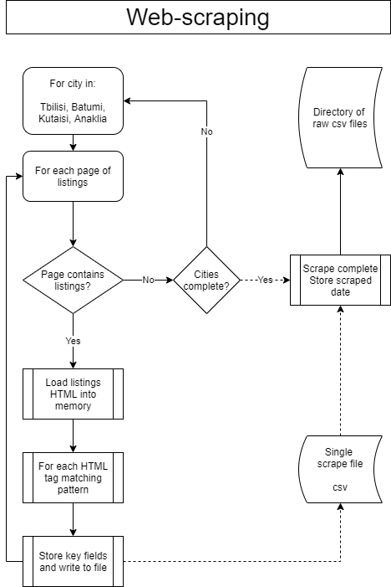
IMPLEMENTATION
Terrible setup, do not emulate!
Old laptop
Bad battery
CSV
Data acquired
1,198 scrapes over 194 days
1,480 unique listings
116,276 listing-scrape records

Slide 11
PROCESSING
Sales Estimation
Substance Labelling

Slide 12
SALES ESTIMATION
Reviews unavailable and possibly inaccurate
Daily cumulative difference in stock levels
Excluding restocking
Notes:
The most important question for the study was sales. It’s one thing to be able to say that particular drugs are being sold, but another to say which are being bought. I was most interested in what people are buying, so I needed a way to estimate sales.
As I noted before, other researchers doing similar work have used user reviews as a proxy for sales, but I wasn’t able to get this information. I was also a little unsure about how well reviews work as a proxy. Whilst sites often require users to leave reviews, some may not, some may get deleted, a seller might also sell offline this wouldn’t be recorded in a review.
What I did have available was the listed stock. I figured I could use the advertised stock to estimate sales, and I think it worked pretty well. I made multiple scrapes a day, usually around four or five. I then calculated sales per listing on a daily level, based on changes in vendor stock.
So taking this listing on the right as an example, we could say that if it shows 7 units available during my first scrape and five in my second – that’s two sales.
Sometimes vendors restock and we see stock levels increase from one scrape to the next. I just ignored these and moved to the next one. This does mean I’ll have missed a few sales, but restocking was actually surprisingly rare – with most vendors preferring to create new listings for new batches.

Slide 13
SUBSTANCE LABELLING
WHAT I DID
BETTER OPTIONS
Keyword based:
For example “coke”, “cocaine”, “coca”, “Charlie” are matched to Cocaine
Highly problematic at scale:
1,000s of different slang terms, particularly for cannabis strains
Multiple hits
“Buy my GREAT ecstasy MDMA pills”
“Amphetamine” and “Methamphetamine”
Site defined categories
Machine learning models:
Text (keyword, vector)
Other data, (e.g. price, weight)
Notes:
Going from part of the project I’m quite please with to something that I’m not, the other major part of the processing component was substance labelling.
I used a keyword-based matching system to identify substances from their descriptions. This worked fine to start with, but fell apart quite quickly when the dataset began to grow.

Slide 14
ANALYSIS
Scale
Diversity
Covid-19

Slide 15
SCALE
Country | Total revenue (USD, mil,) | Study duration (months) | Monthly revenue (USD, mil.)
UK | 33.56 | 11 | 3.05
Germany | 22.37 | 11 | 2.03
Netherlands | 12.26 | 11 | 1.11
France | 4.52 | 11 | 0.41
Georgia† | 1.60 | 6.3 | 0.25
Spain | 1.31 | 11 | 0.12
Belgium | 1.19 | 11 | 0.11
Rest of Europe | 6.81 | 11 | 0.62
Over 1.5 million USD in transactions conducted between February and August 2020.
On an average day:
Over USD 8,000 in revenue is generated by transactions in Georgia
Packages worth around USD 35,000 hidden throughout major cities
Substantial in international comparison, exceeding monthly cryptomarket revenue for Spain and Belgium combined.
Source: Christin and Thomas (2019) excluding (†) CRRC (2020)
Notes:
One of the most important findings arising from the study is scale.
The report finds over one and a half million dollars worth of transactions taking place over the February-August period. This amounts to around 8,000 dollars a day or 250,000 dollars a month from transactions in Georgia alone.
These figures are averages across the whole dataset, and as we’ll see there’s been a large impact from the Covid outbreak, but this is really quite a substantial figure.
If we compare the revenue seen from transactions on Matanga to estimates from other cryptomarkets in Europe, we see that revenue from Georgia exceeds that of Spain and Belgium combined.
This is quite a striking finding that needs to be taken in context:
We’re comparing revenue here, and prices are considerably higher in Georgia than Europe. For example, a gram of cocaine in Georgia on Matanga costs about 200 dollars, compared with around 75 across Europe in the Christin and Thomas study.
Cross study comparisons are always tricky, and the Christin and Thomas study has a number of methodological differences with what we’ve done here.
Nonetheless, I think it’s still fair to say that Matanga is at the very least, relatively busy.
Why is this?
We know that despite having very high per-capita rates of injecting drug use, overall drug use prevalence in Georgia is low compared to many of the countries we see here.
We also know that cryptomarket trade makes up a very small proportion of Western drug markets.
I think what we’re seeing here is that cryptomarkets may be proportionally much more important in Georgia than they are in Western markets. That is, the online trade from these sorts of platforms may be a larger fraction of the total trade here than in Europe.
This is actually something we’re beginning to see in Russia, where the Hydra market is also understood to be substantially larger and domestically more important than Western cryptomarkets.

Slide 16
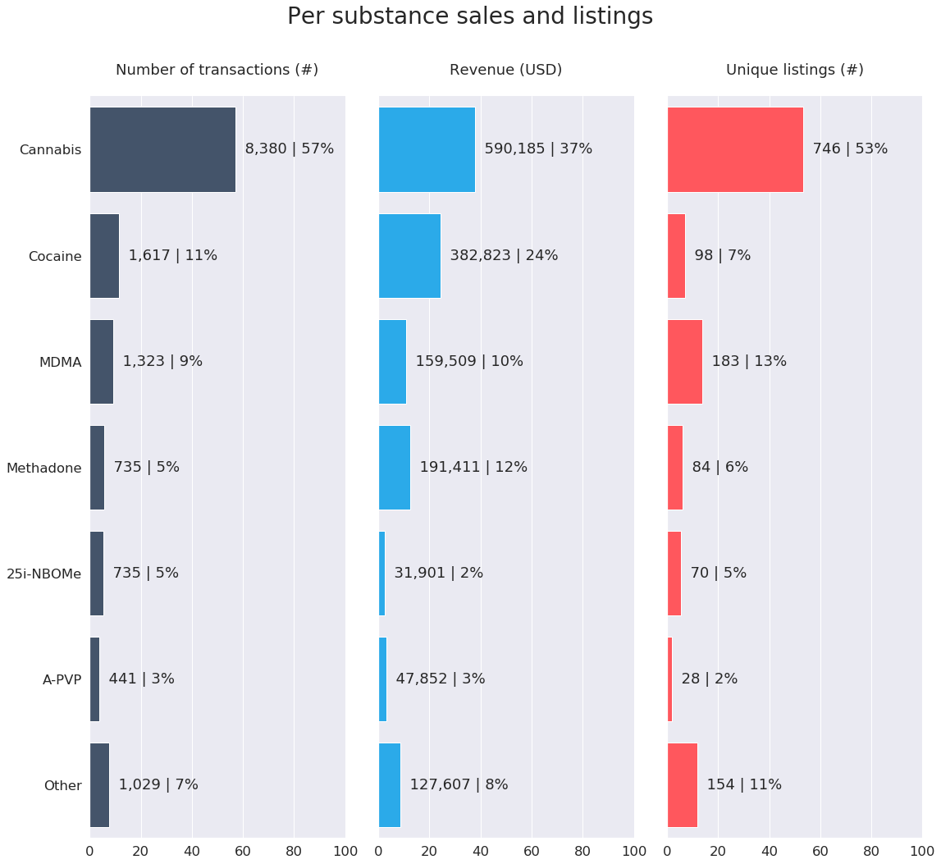
DIVERSITY
Mostly cannabis, particularly when looking at transactions and listings
Many sales for cocaine, MDMA, powdered methadone, 25i-NBOMe and Alpha PVP.
Smaller amounts of 10 other drugs, including one unidentifiable substance
Notes:
The other thing we see is quite striking diversity in what’s being sold. In total, we identify sixteen unique substances, including one I’ve not actually been able to identify.
Most trade is for cannabis, and we’ll see in the next slide that it’s become proportionally more important throughout the six months of the study. We see five other substances that really stand out in terms of volume of trade: the next most popular substances are cocaine and MDMA, followed by powdered methadone which we’ll touch on more in a minute.
We also see a lot of trade for the new psychoactive substances, 25i-NBOMe and Alpha PVP. I found it really interesting that these two relatively esoteric substances eclipse substances with a longer history of human use.
Buried away in the Other bar of this chart, with much lower activity than NBOMe and Alpha PVP we have:
Heroin (sirets)
LSD
Ketamine
Amphetamine and Methamphetamine
Buprenorphine (Subutex)
We also see
Another NPS, Mephedrone
Gabapentin
Bupropion Hydrochloride
We also have our unknown substance, listed as NZT-Mindstorm; if anyone has any idea what that might be, please let me know. There was actually quite a bit sold, at around 200 USD a gram.
What is just as interesting is what we don’t find. We see no synthetic cannabis and we see no fentanyl, both of which have been the subject of a lot of public discussion in recent years.

Slide 17
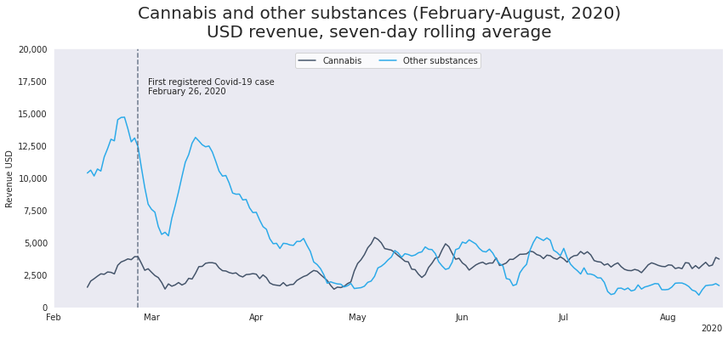
COVID-19
Substantial decline in activity following the outbreak of Covid-19
Steep fall in daily revenue, around fifty percent following the first case
Cannabis revenue appears to increase, overtaking all other substances in the summer
Scraping ceased in August, but manual review late September suggests the market may have recovered
Notes:
We also see that the market seems to have been heavily impacted by the outbreak of Covid-19.
We’ve seen around a 50% fall in revenue since the first case, and some dramatic oscillations in activity in and around the lockdown period.
One interesting dynamic that we’ve seen is the growth of the cannabis market throughout the monitoring period, both in absolute terms and as a proportion of the overall market.
I also have a last minute update here.
Scraping ended after my scraper broke down in mid August. This happened a couple of times, but as I was moving to publishing, I gave up trying to fix it.
I actually went on the site again this morning in preparation for the talk, and saw that things appear to have bounced back quite dramatically.
All I was able to gather was a quick manual count of listings, as I need a few proper scrapes to get fuller data. But this morning there were 146 listings up in Tbilisi alone, this is actually more than we saw before Covid!

Slide 18
QUESTIONS

Slide 19
PROJECT REPOSITORY
https://github.com/crrcgeorgia/matanga

Slide 20
SUPPLEMENTAL

Slide 21

LIMITATIONS
This is likely only a fraction of the total online trade, much less the offline trade.
Likely an underestimation of sales from within the site.
Pre-Covid baseline from a likely slow period, it has also been an unusual year.
Notes:
Before I move on to presenting the findings, I want to be clear about the limitations of the study.
Firstly
The main limitation of the study is, as discussed, that Matanga is one of many online platforms, and there is no evidence to suggest that most drug users buy online – quite the opposite. Accordingly, we should be careful about extrapolating out from these findings to the entirety of the Georgian drug market. For example, we see a lot of cocaine here, but I don’t think that should lead us to believe most drug users in Georgia are using it.
Nonetheless, if we see a drug is present online in large quantities, it is reasonable to believe that it is present in the country in large quantities. And trends that appear online – for example in peaks and troughs in supply – may be a good reflection of markets more broadly.
Secondly
For a number of technical reasons, which I give more space to in the report and methods annex, the sales figures provided are likely an underestimate from within the site.
As discussed previously, I’ve largely ignored the pre-order market. I think that ready inventory provides a much more reliable indication of what’s actually out there, but this also means I’m definitely not capturing everything.
It’s also entirely possible that I miss sales when vendors restock supplies. I think this is likely negligible, but something to be aware of.
Finally
I has also been a very weird year. We’ll see that Covid has impacted sales quite a lot, and my pre-Covid baseline is from February, which isn’t really a period where I’d expect to see activity at it’s highest. I don’t think my findings are necessarily indicative of what a normal year would look like, whatever that means in 2020.
OK, with those caveats in place. Let’s move on to the findings.

Slide 22
LEARNING

Slide 23
WHAT I LEARNED
Think before starting to code
Know when to stop
Use SQL
Selenium wasn’t necessary
Be more adventurous
More scraping for better substance labelling
Attempt to find a work around for CATCHPAs

